Slide 1
Power BI
Hands On Turorial

Slide 2


Slide 3
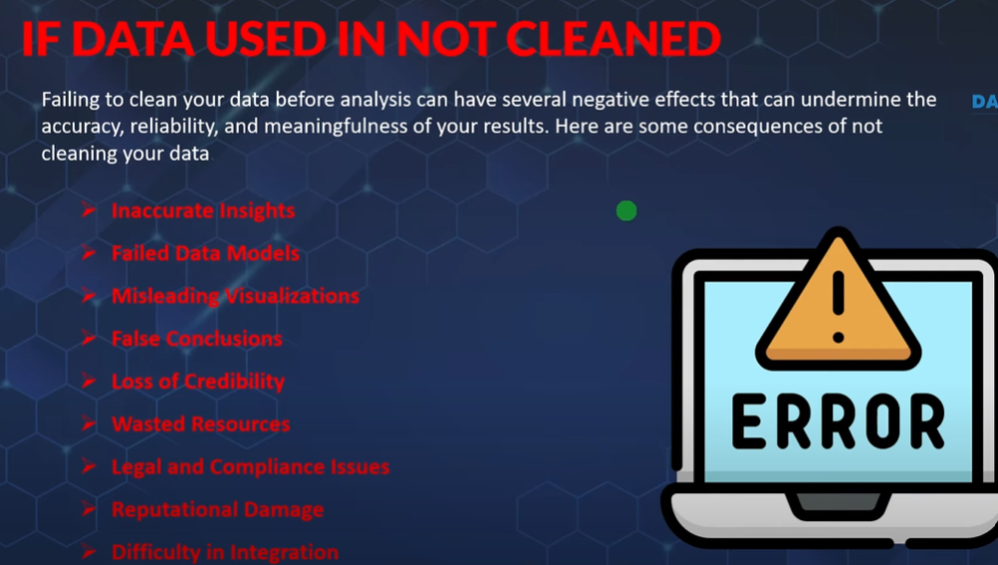

Slide 4
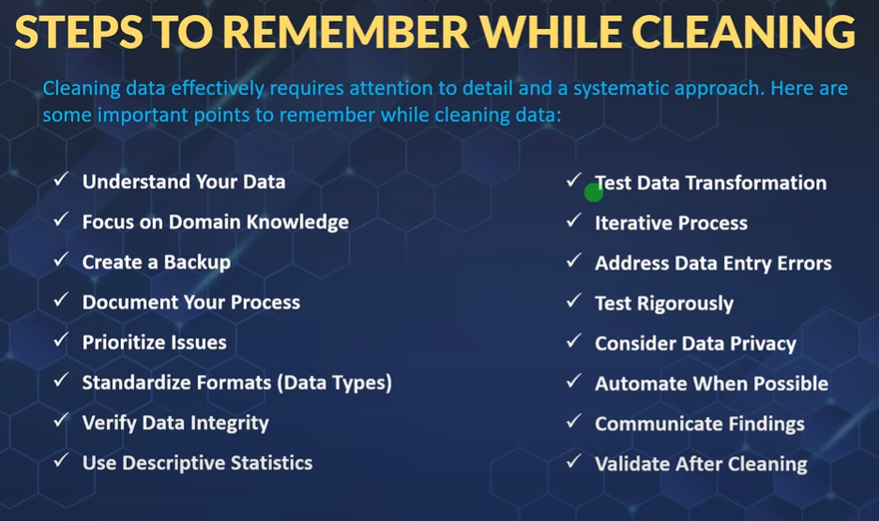

Slide 5
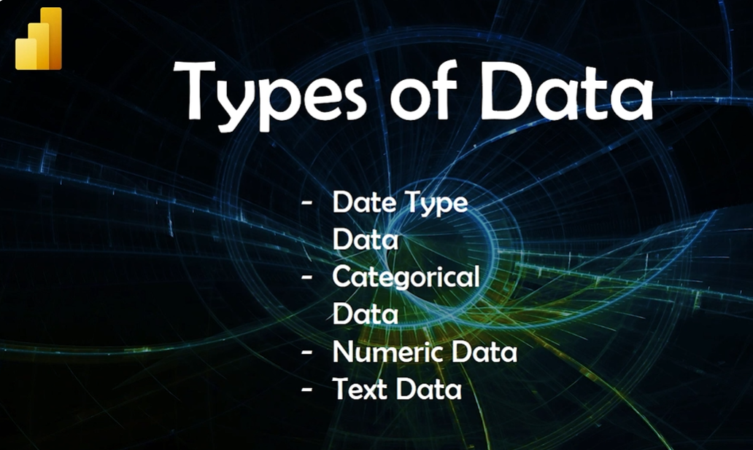

Slide 6


Slide 7
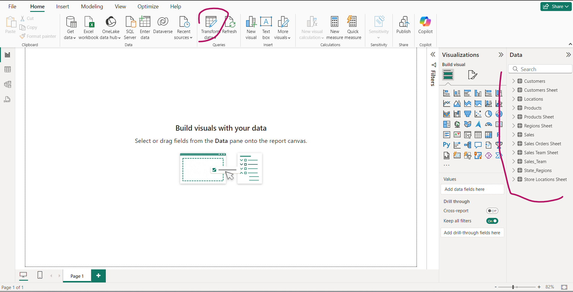

Slide 8
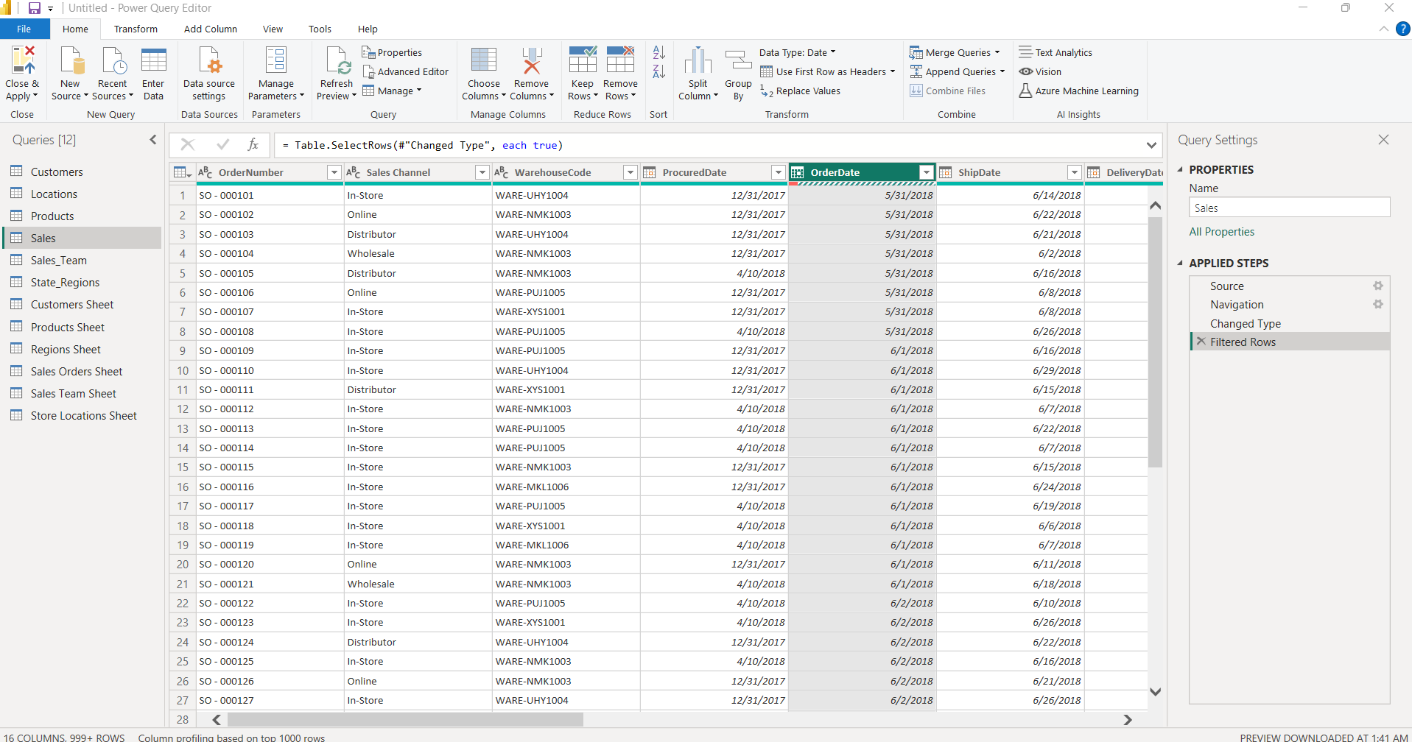
Separate window Called “Power Query Window” would open

Slide 9
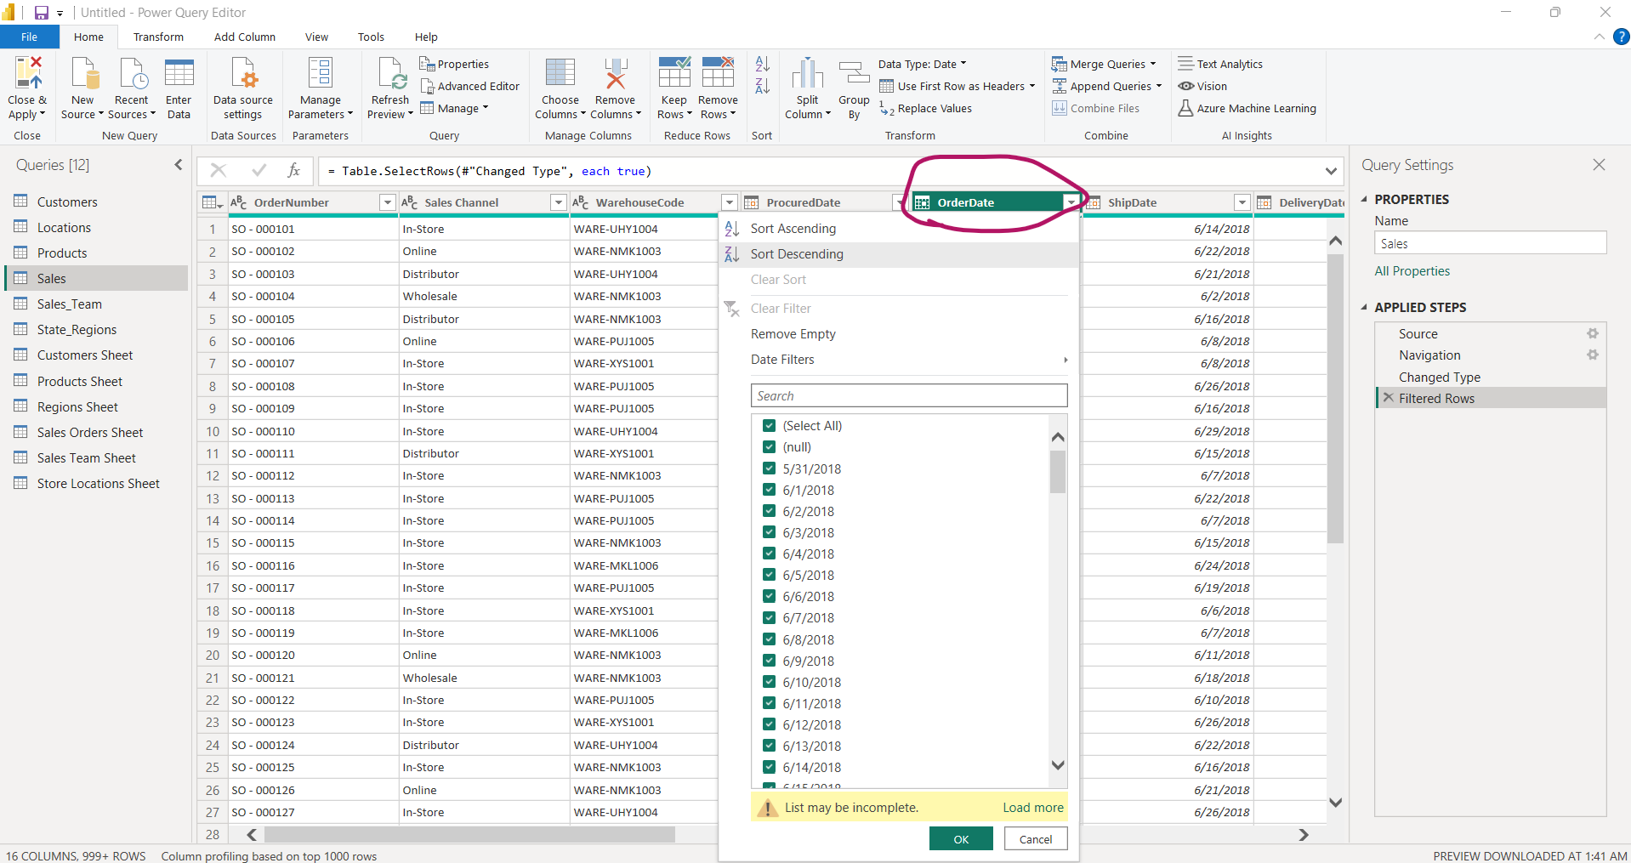
Sale> Order date showing arrow

Slide 10
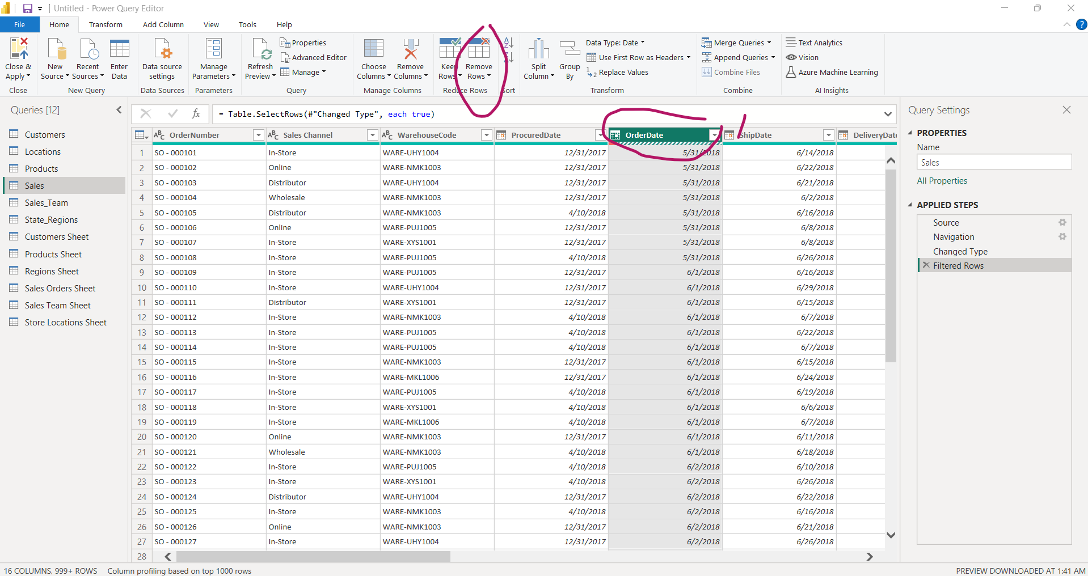
To remove error

Slide 11
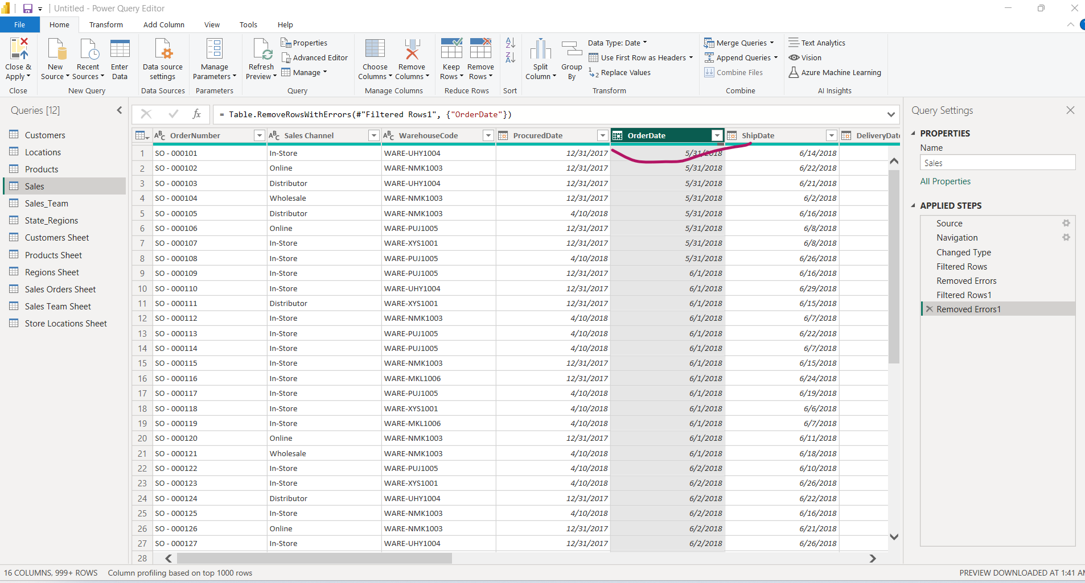
Data Types Error would be removed

Slide 12
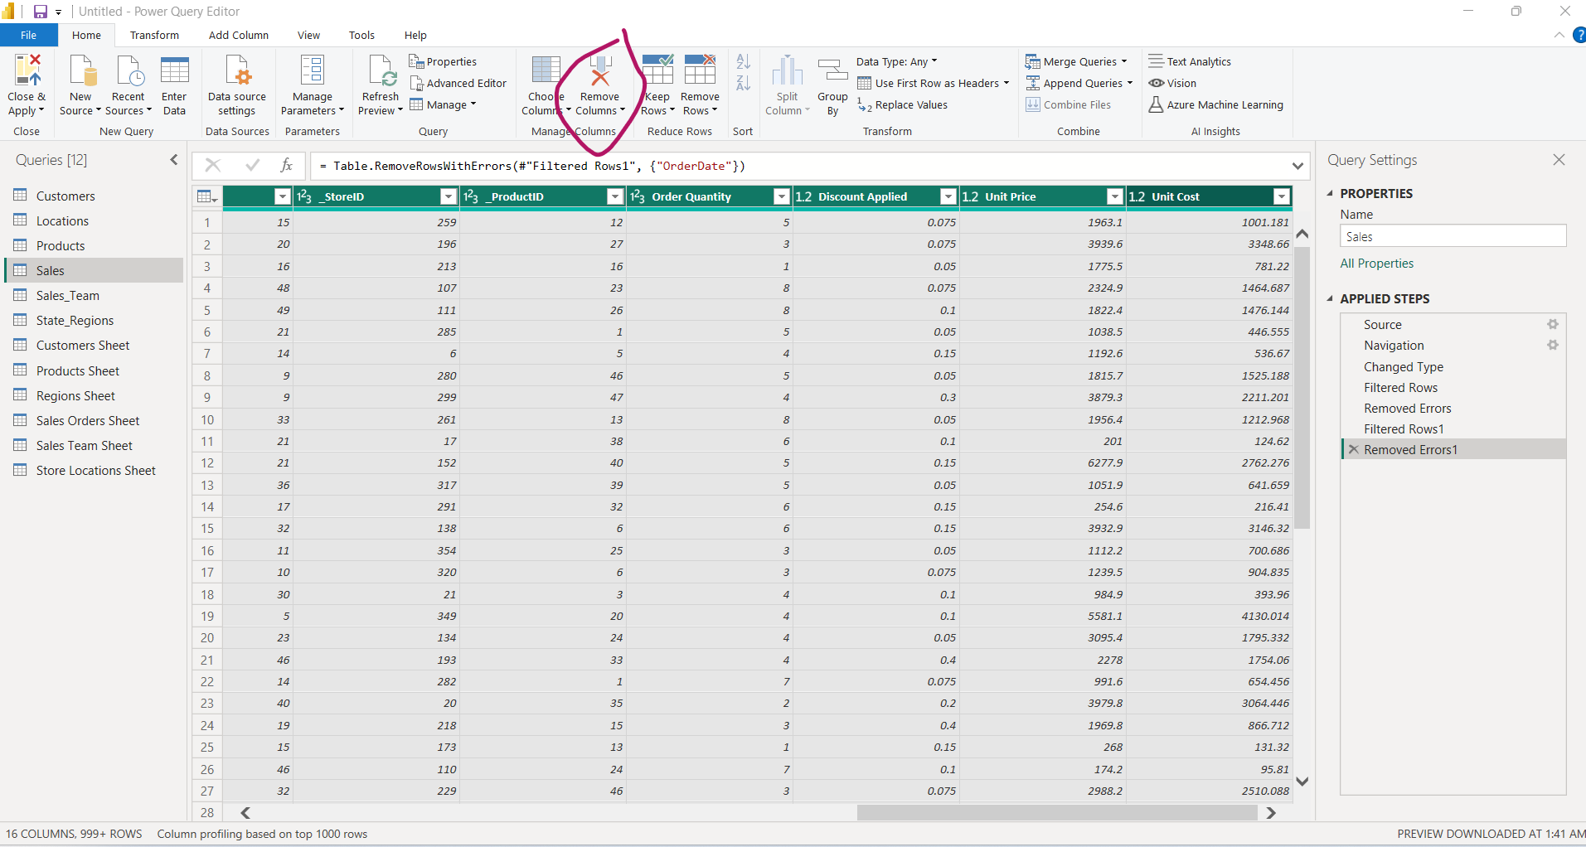
To Clean all data. Press shift and left arrow

Slide 13
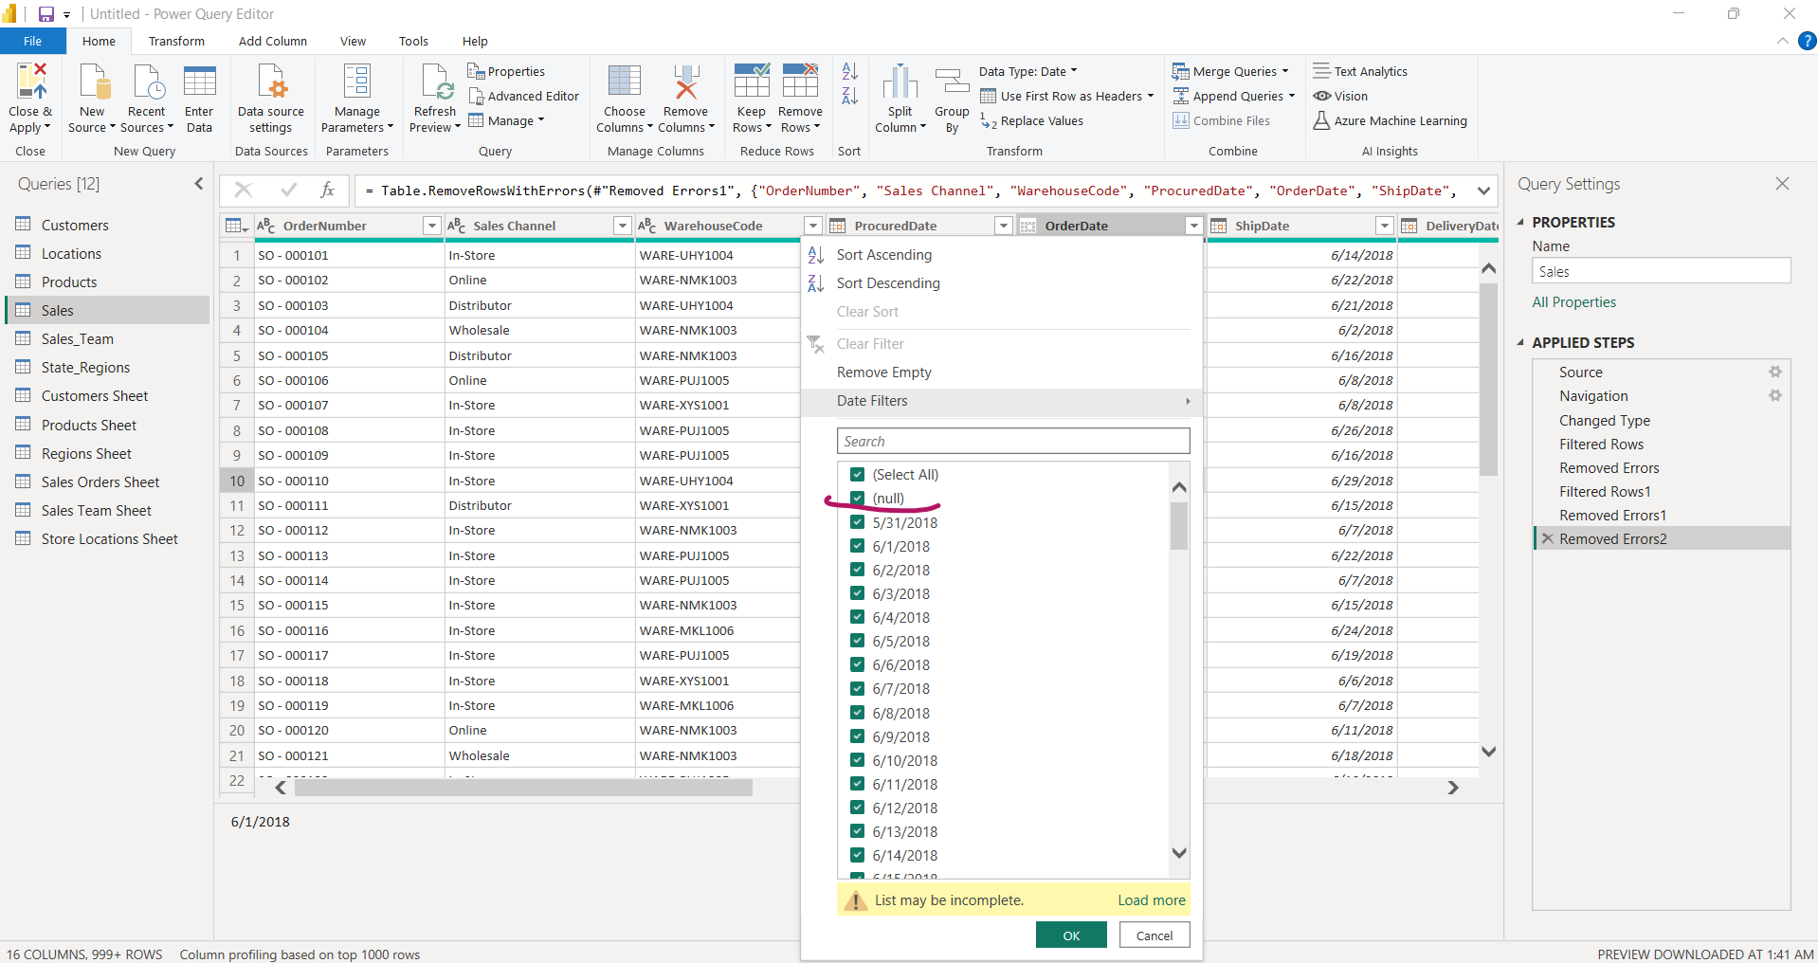
To Remove Null and blank Values
1. Select column and goto Remove rows > Remove Blank rows
2. From a drop down list deselect Null field

Slide 14
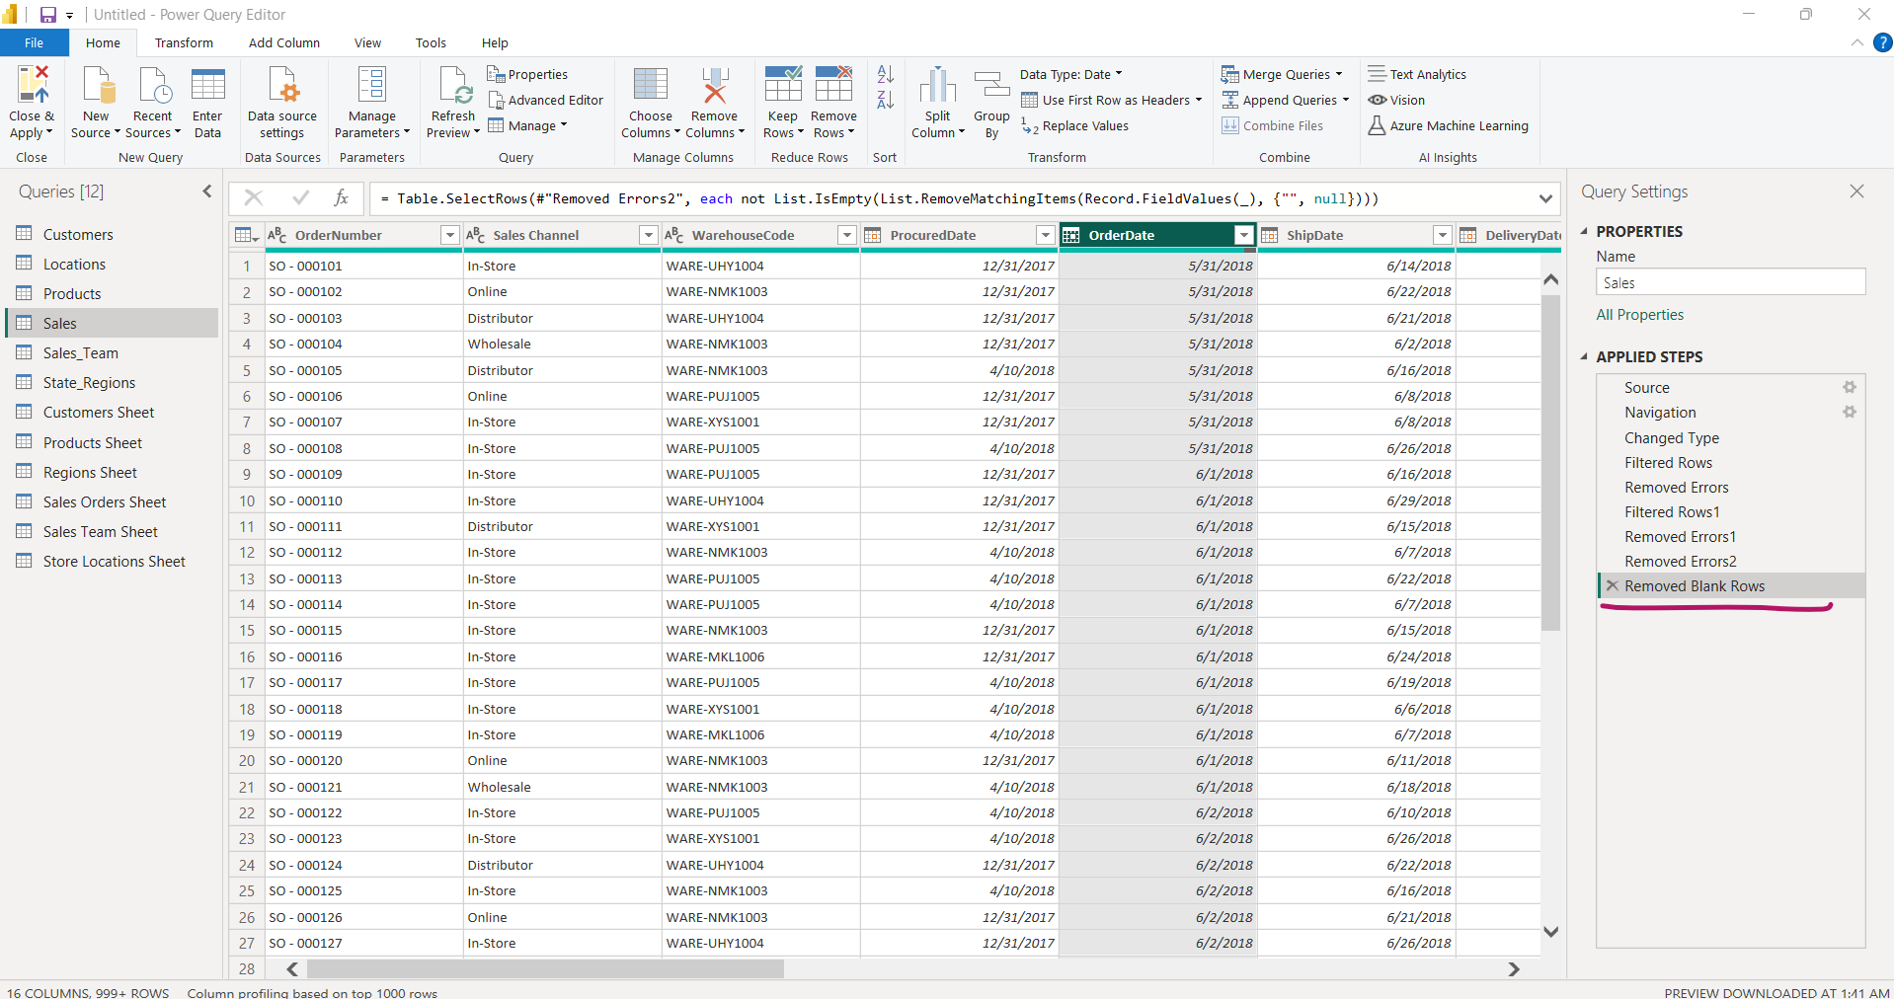

Slide 15
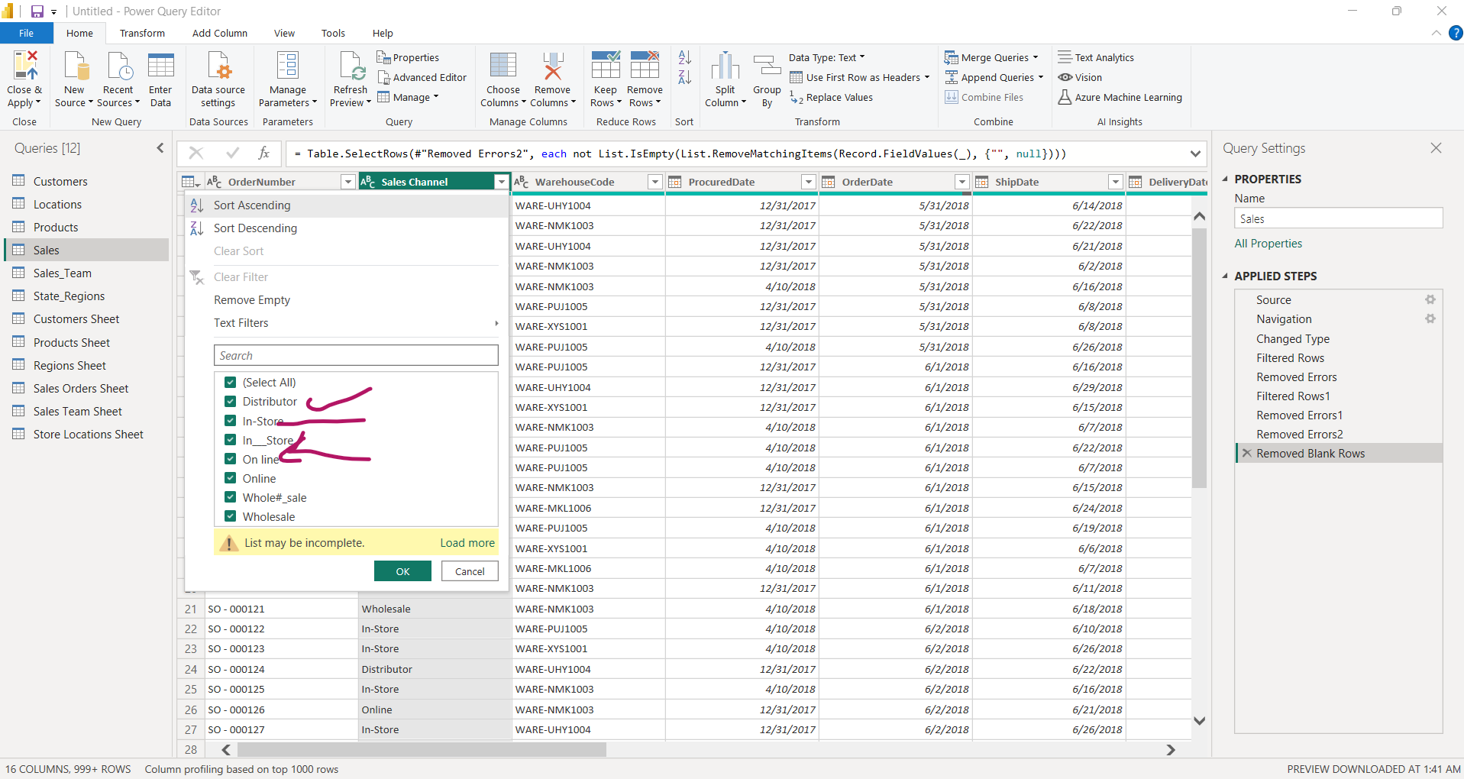
Sales Channel is Categorical data

Slide 16
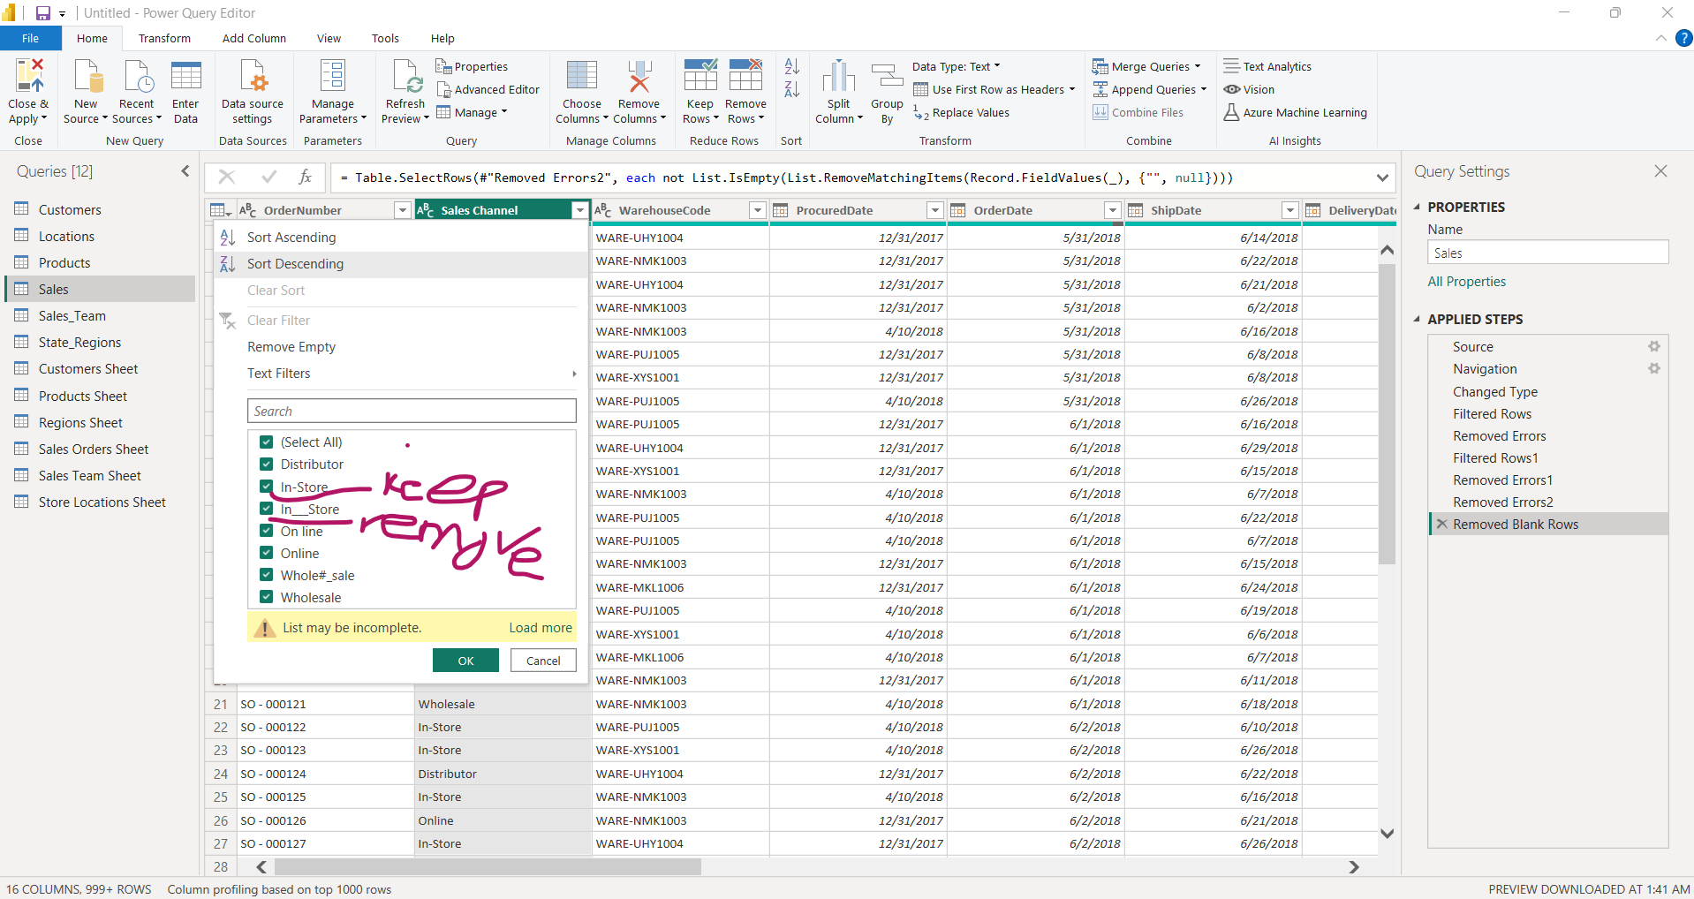
Certain data to be kept and replace

Slide 17
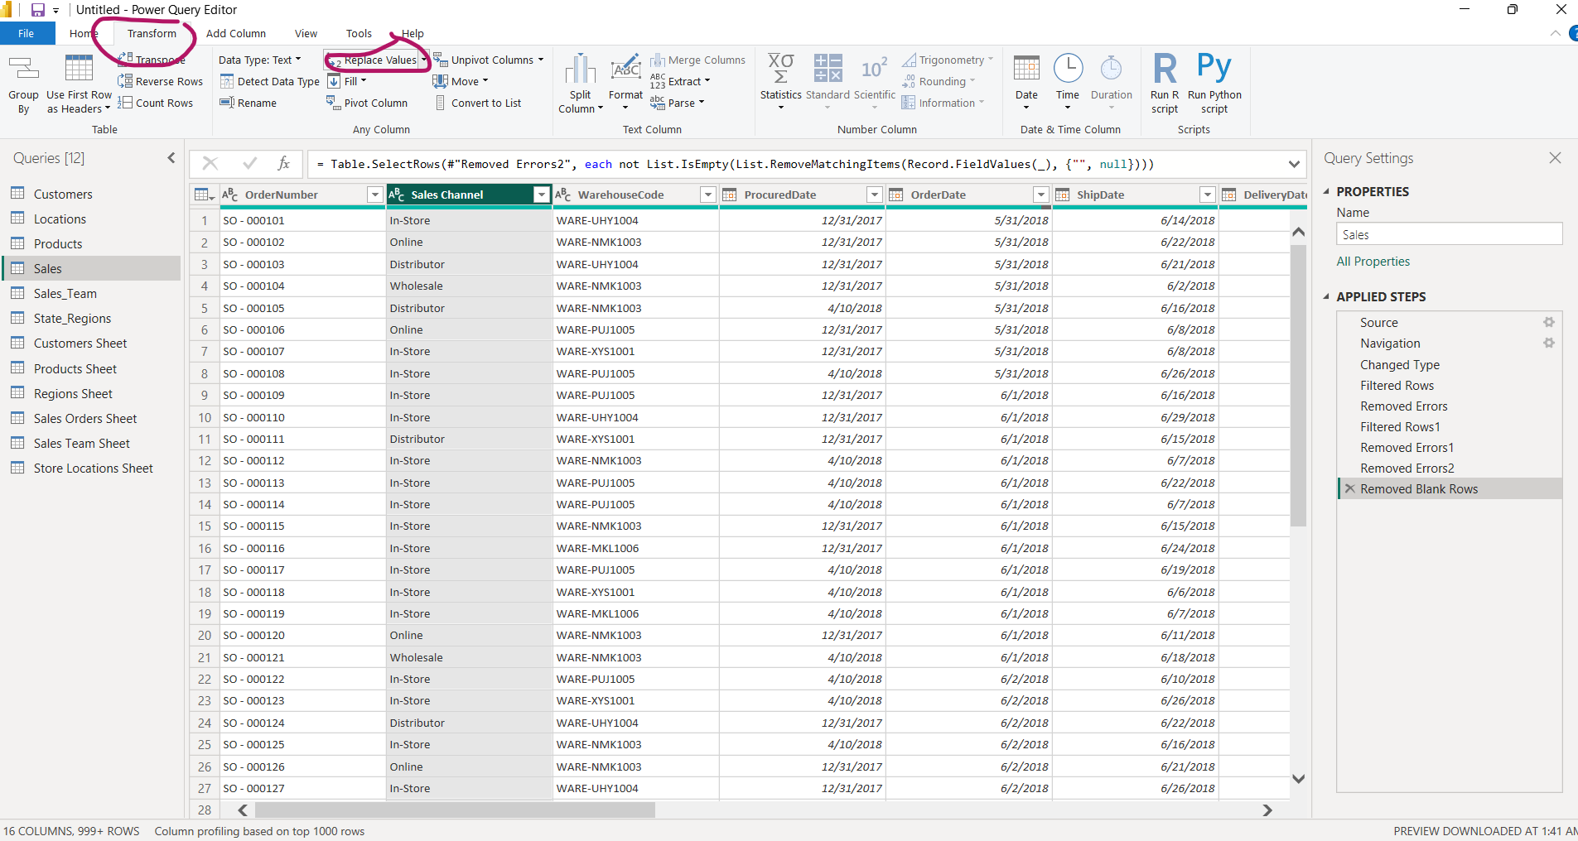
Replace values

Slide 18
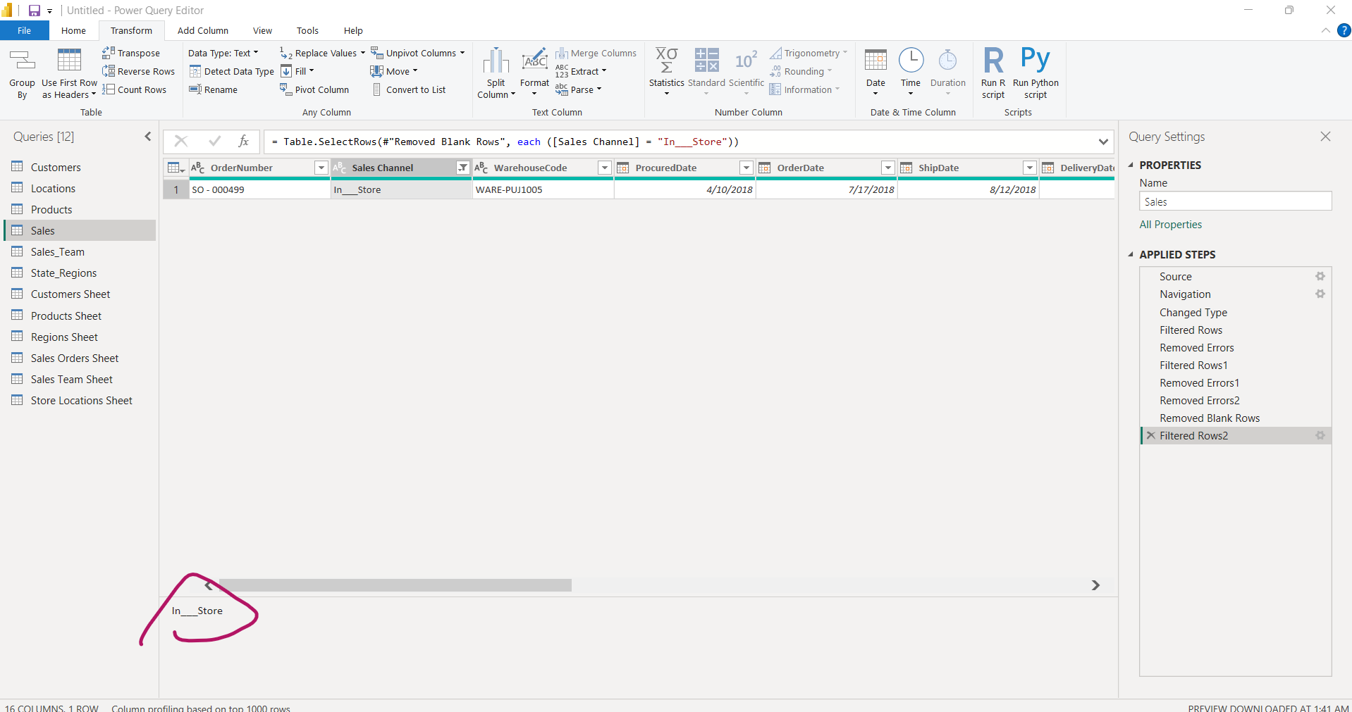
Copy in__store from

Slide 19
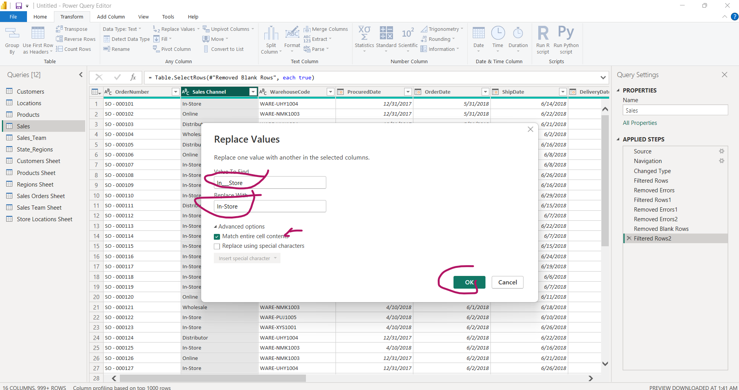
Replace all “In__Store ” with “In-Store”

Slide 20
How to clean Numeric Data type

Slide 21
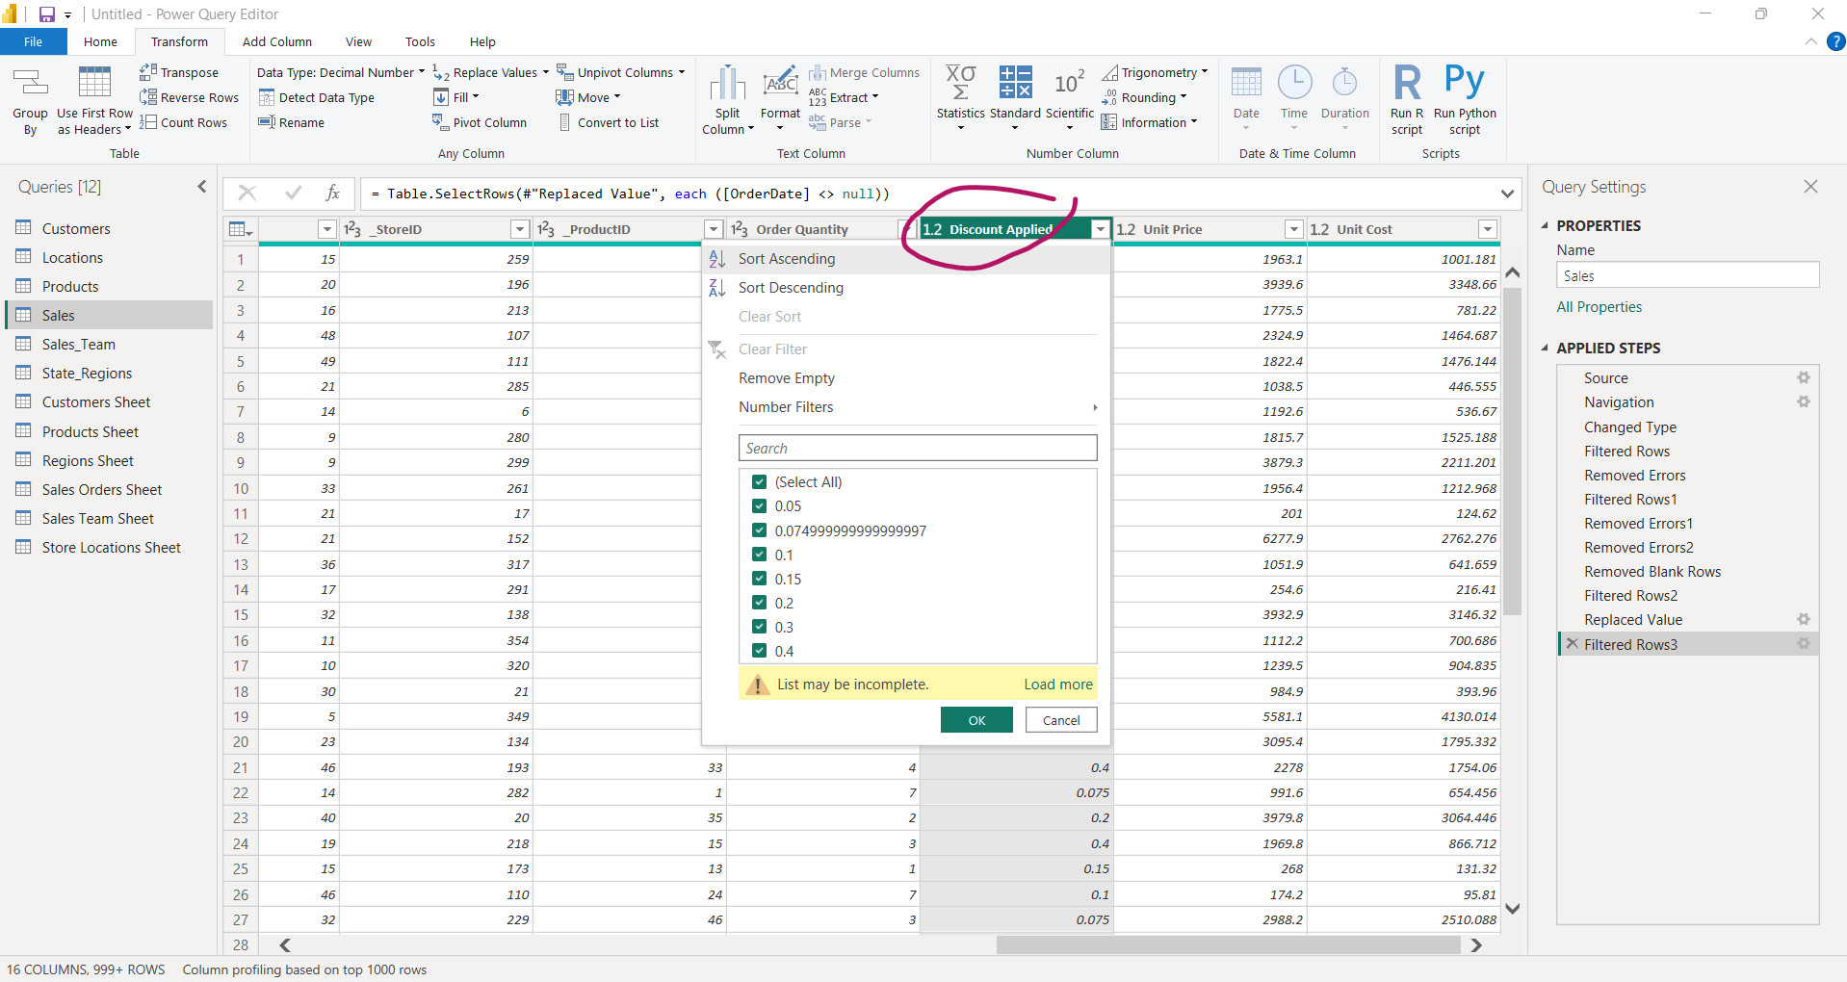

Slide 22
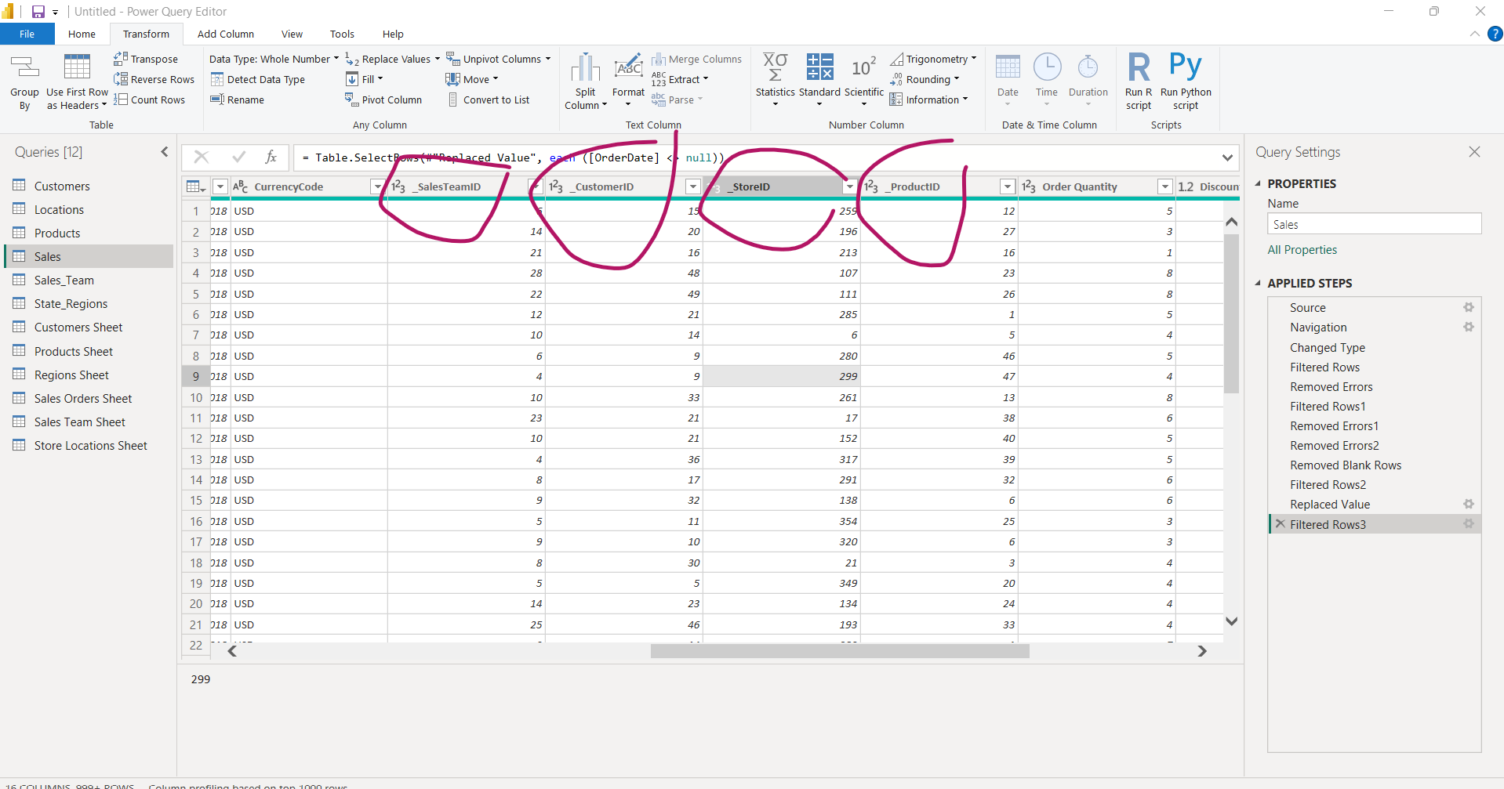
Cleaning Id integer fields are difficult to clean as they are foreign keys

Slide 23
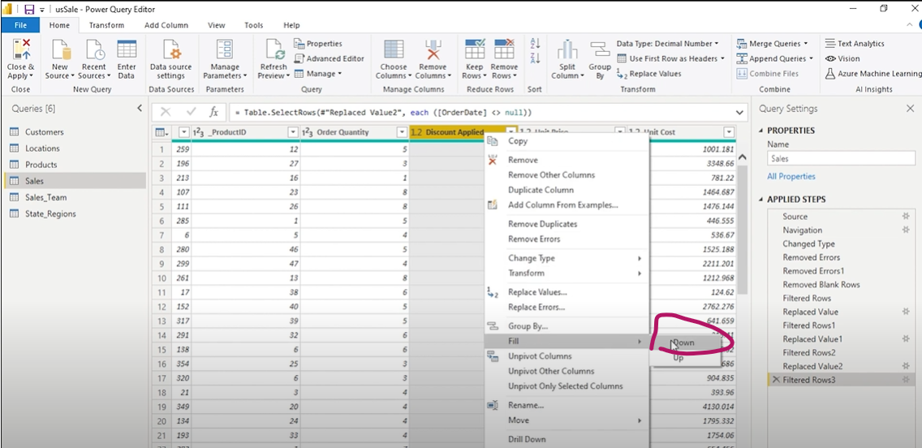
For Numeric field replace null with fill up or fill Down

Slide 24
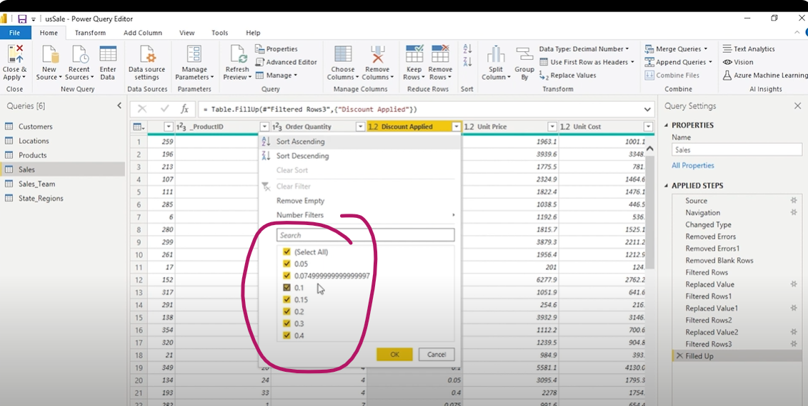
Null values are gone

Slide 25
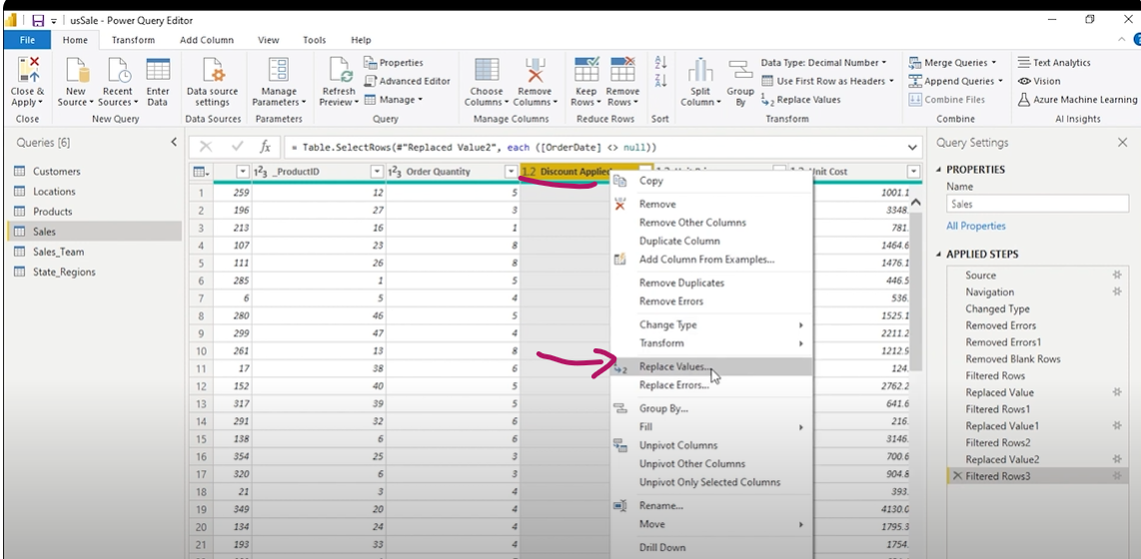
For Numeric field replace null with Average value or through visualization

Slide 26
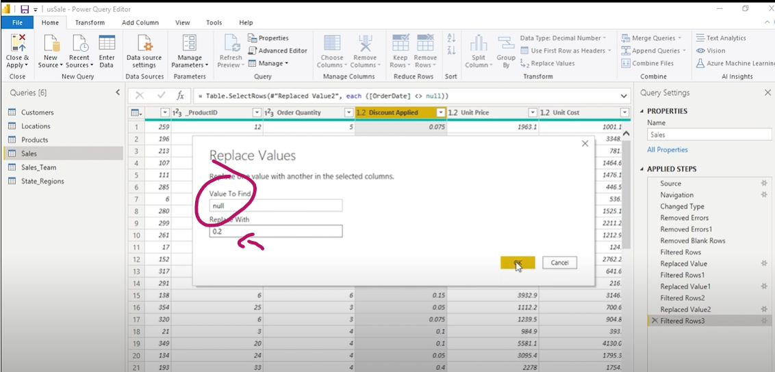
Null with Average value of 0.2

